Slide 1
DEEP LEARNING FUNDUS IMAGE ANALYSIS FOR EARLY DETECTION OF DIABETIC RETINOPATHY
TEAM LEAD : Narmadha.R
TEAM ID : PNT2022TMID4355
TEAM MEMBERS :
Soundharya .B
Fariza . A
Madhubala .K
MENTOR : Dinesh Ganesan

Slide 2
INTRODUCTION
Diabetic Retinopathy (DR) is complication of diabetes that causes lesions on the blood vessels of Retina.
According to a research,2.6% of blindness caused by Diabetic Retinopathy(DR).
Short Flaws :
Time ,Cost ,Effort .
Manual diagnosis may cause Misdiagnosis.

Slide 3
OBJECTIVES
The main objective is the early detection of diabetic retinopathy to prevent vision loss .
To overcome the disadvantages of manual diagnosis .
To save time and reduce the risk of misdiagnosis.

Slide 4
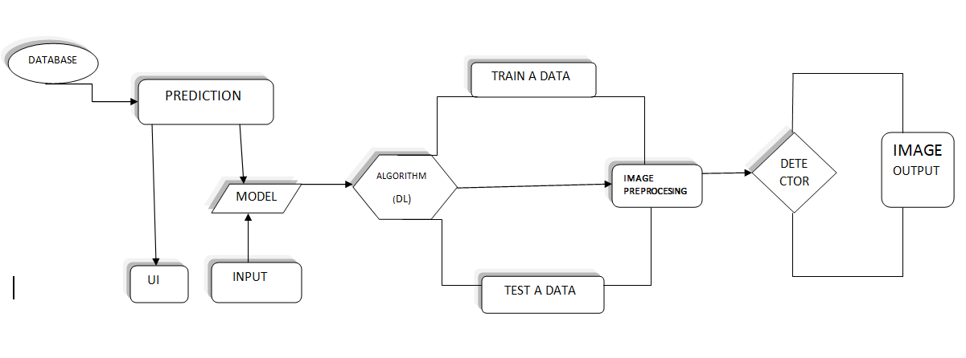
BLOCK DIAGRAM

Slide 5
METHODOLOGIES
Python with Numpy &Pandas.
CNN.
Xception .
Python flask frame work.
IBM Watson cloud.
Tensorflow & keras.

Slide 6
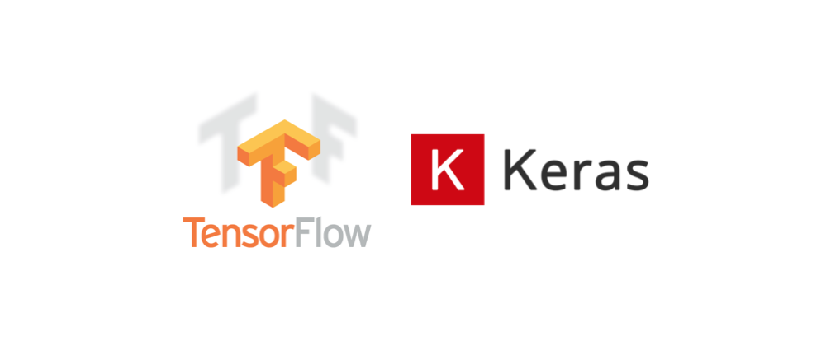
TENSOR FLOW & KERAS
Tensor Flow is a free and open source software library for machine learning and artificial intelligence.
It can be used across a range of tasks but has a particular focus on training and inference of deep neural networks.

Slide 7
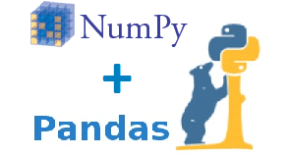
PYTHON WITH NUMPY AND PANDAS
Numpy is a library for python it supports large and multi - dimensional arrays and matrices.
Pandas is a high-level data manipulation tool that is built on the Numpy package.

Slide 8
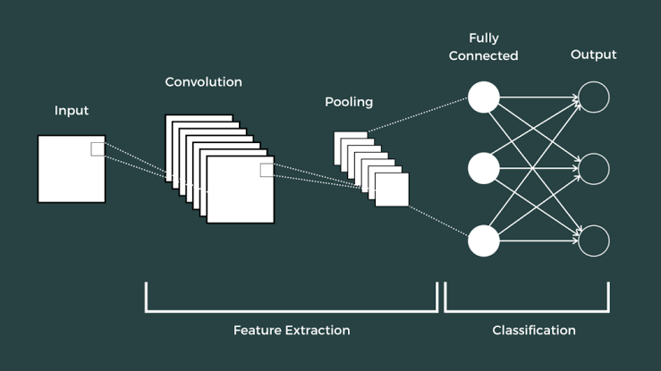
CONVOLUTION NEURAL NETWORK (CNN)
Convolution Neural Network(CNN) is a network architecture for deep learning.
It is used for finding patterns in images to recognize objects and classification.

Slide 9
XCEPTION V3
It is a convolution neural network(CNN).
It classify images into 1000 objectives.
Xception model with transfer learning approach, provides the reliable classification model that can generalized to the histo-pathological images.

Slide 10

PYTHON FLASK FRAME WORK
Flask is a micro web framework written in python.
It is classified as a micro framework because it does not require particular tools or libraries.
Flask is based on the Werkzeg WSGI tool kit and the Jinja template engine.

Slide 11
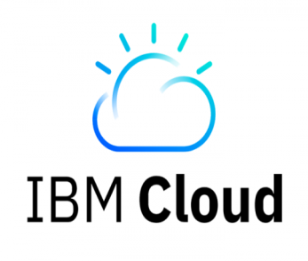
IBM WATSON CLOUD
A part of IBM cloud that is precisely used to create a models.
It holds the model and used to train and test the data in the phase of project development.
We’re creating a Database link towards IBM cloud.
Models are accessed and registered model id , space id are created called Execution.

Slide 12


Slide 13
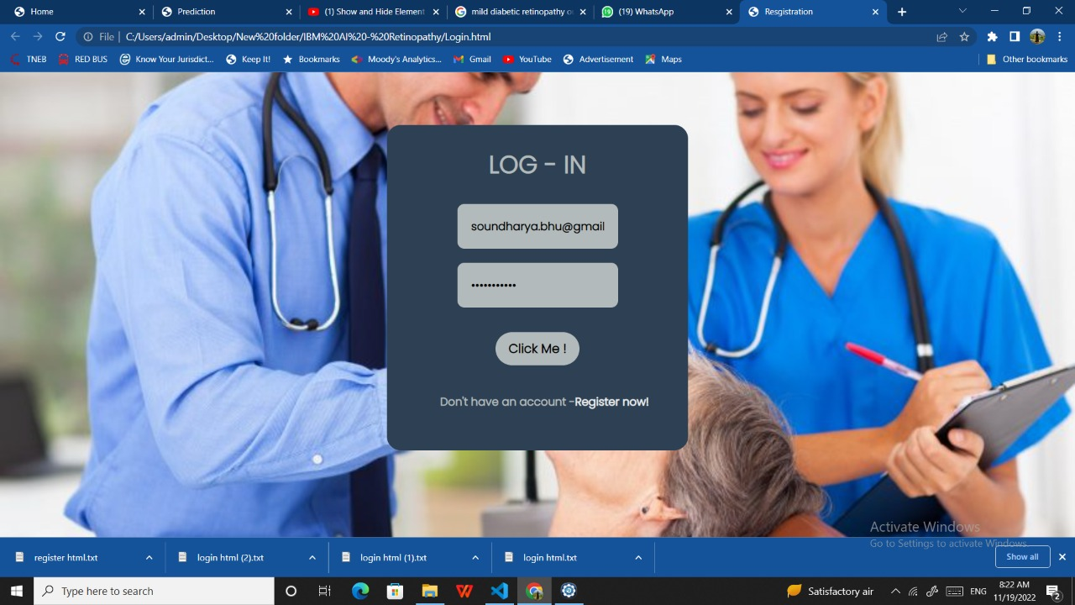

Slide 14
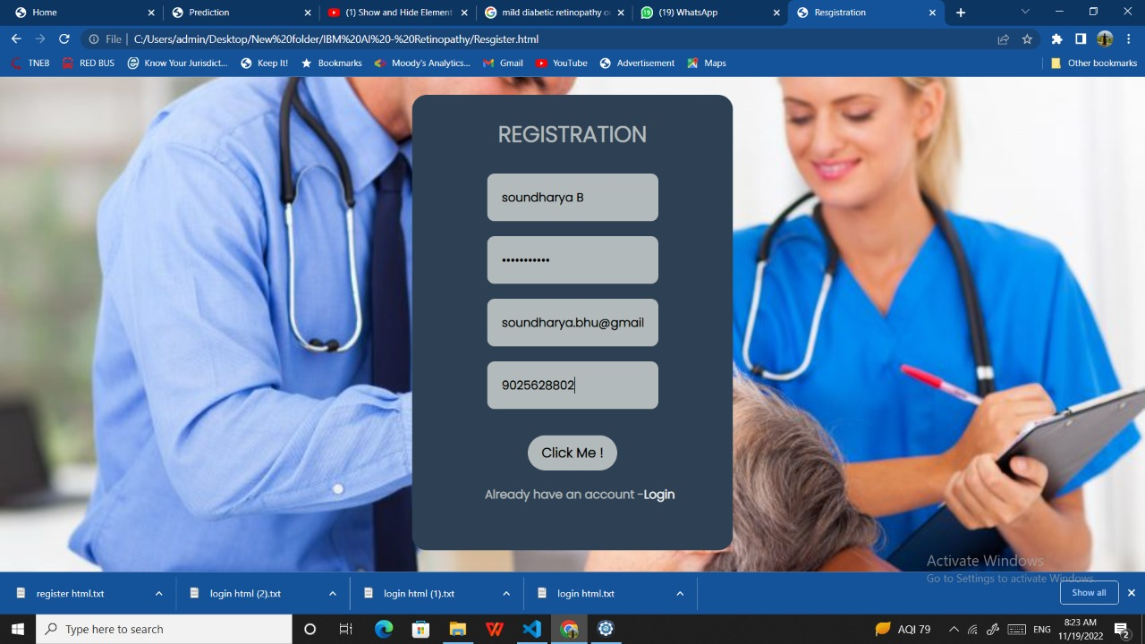

Slide 16
CHALLENGES
DATASETS :
Preprocessed dataset is larger in our project.
Error in algorithm leads to misdignosis.

Slide 17
REFERENCE
International Diabetes Federation. Diabetes atlas. IDF Diabetes Atlas, 9th edition (International Diabetes Federation, Brussels, 2015).
Leasher, J. L. et al. Global estimates on the number of people blind or visually impaired by diabetic retinopathy: A meta-analysis from 1990 to 2010. Diabetes Care 39, 1643–1649 (2016)
Ting, D. S. W., Cheung, G. C. M. & Wong, T. Y. Diabetic retinopathy: Global prevalence, major risk factors, screening practices and public health challenges: A review. Clin. Exp. Ophthalmol. 44, 260–277 (2016).

Slide 18


